Slide 1
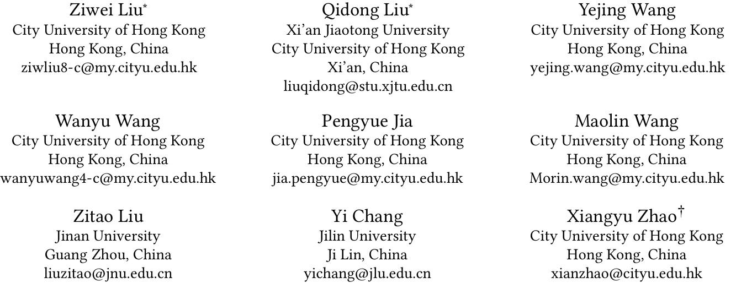
ATAI
Advanced Technique of Artificial Intelligence
ATAI
ChongqingUniversity _{AdvancedTechniqueof}
of Technology Artificial Intelligence
Chongqing University of
Technology
Chongqing University ^{ATAI}
_{of Technology} Advanced Techniqueof
Artificial Intelligence
Chongqing University of Technology
Chongqing University of Technology
Bidirectional Gated Mamba for Sequential Recommendation
https://github.com/ziwliu-cityu/SIMGA
——AAAI_2025
Reported by Jinfei Chen
1

Slide 2
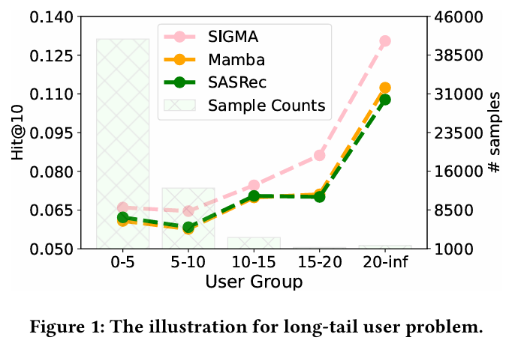
ATAI
Advanced Technique of Artificial Intelligence
ATAI
ChongqingUniversity _{AdvancedTechniqueof}
of Technology Artificial Intelligence
Chongqing University of
Technology
Chongqing University ^{ATAI}
_{of Technology} Advanced Techniqueof
Artificial Intelligence
Chongqing University of Technology
Chongqing University of Technology
Motive
However, integrating Mamba directly into SRS poses several challenges.
Its inherently unidirectional nature may constrain the model’s capacity to capture the full context of user-item interactions, while its instability in state estimation can compromise its ability to detect short-term patterns within interaction sequences.

Slide 3
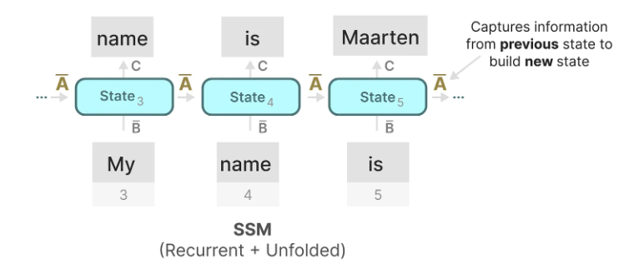
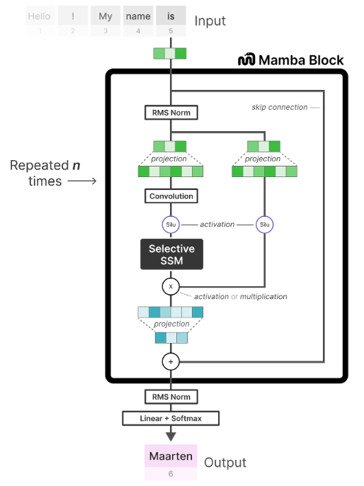
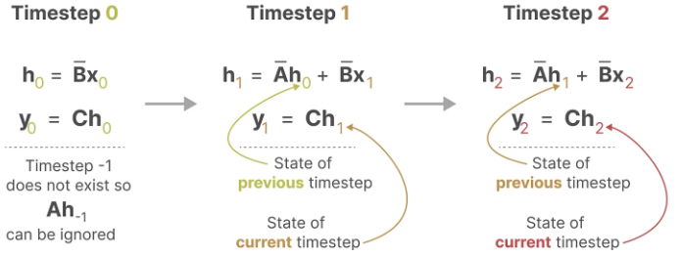
ATAI
Advanced Technique of Artificial Intelligence
ATAI
ChongqingUniversity _{AdvancedTechniqueof}
of Technology Artificial Intelligence
Chongqing University of
Technology
Chongqing University ^{ATAI}
_{of Technology} Advanced Techniqueof
Artificial Intelligence
Chongqing University of Technology
Chongqing University of Technology

Slide 4
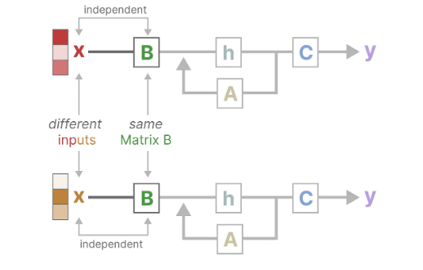
ATAI
Advanced Technique of Artificial Intelligence
ATAI
ChongqingUniversity _{AdvancedTechniqueof}
of Technology Artificial Intelligence
Chongqing University of
Technology
Chongqing University ^{ATAI}
_{of Technology} Advanced Techniqueof
Artificial Intelligence
Chongqing University of Technology
Chongqing University of Technology
Motive

Slide 5
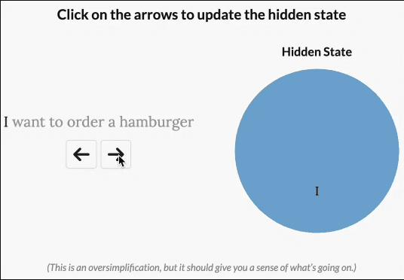
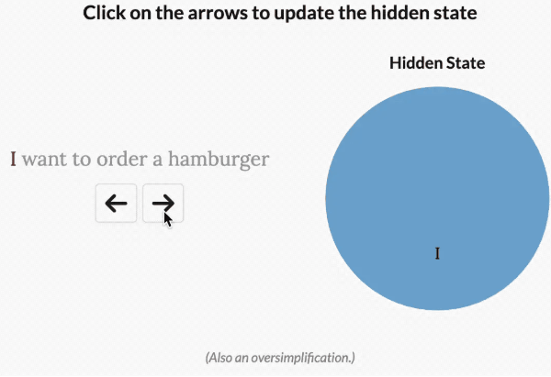
ATAI
Advanced Technique of Artificial Intelligence
ATAI
ChongqingUniversity _{AdvancedTechniqueof}
of Technology Artificial Intelligence
Chongqing University of
Technology
Chongqing University ^{ATAI}
_{of Technology} Advanced Techniqueof
Artificial Intelligence
Chongqing University of Technology
Chongqing University of Technology

Slide 6
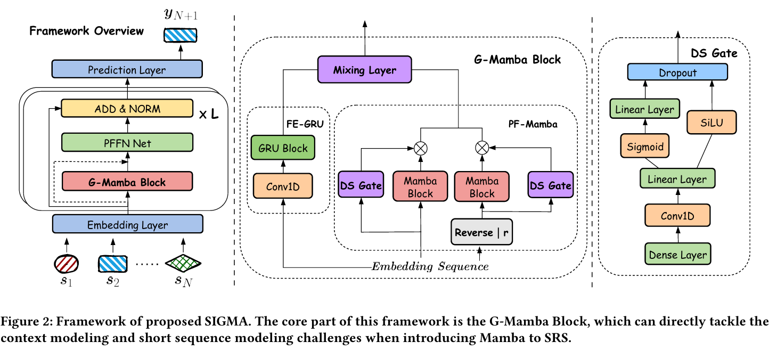
ATAI
ChongqingUniversity _{AdvancedTechniqueof}
of Technology Artificial Intelligence
Chongqing University of
Technology
ATAI
Advanced Technique of Artificial Intelligence
Chongqing University ^{ATAI}
_{of Technology} Advanced Techniqueof
Artificial Intelligence
Chongqing University of Technology
Chongqing University of Technology
Method

Slide 7
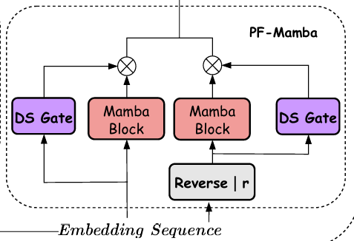
ATAI
Advanced Technique of Artificial Intelligence
ATAI
ChongqingUniversity _{AdvancedTechniqueof}
of Technology Artificial Intelligence
Chongqing University of
Technology
Chongqing University ^{ATAI}
_{of Technology} Advanced Techniqueof
Artificial Intelligence
Chongqing University of Technology
Chongqing University of Technology
Method

Slide 8
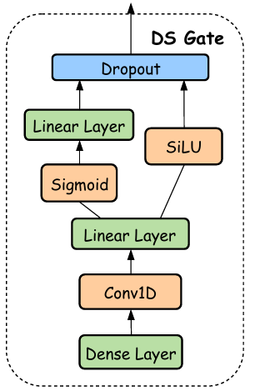
ATAI
Advanced Technique of Artificial Intelligence
ATAI
ChongqingUniversity _{AdvancedTechniqueof}
of Technology Artificial Intelligence
Chongqing University of
Technology
Chongqing University ^{ATAI}
_{of Technology} Advanced Techniqueof
Artificial Intelligence
Chongqing University of Technology
Chongqing University of Technology
Method

Slide 9
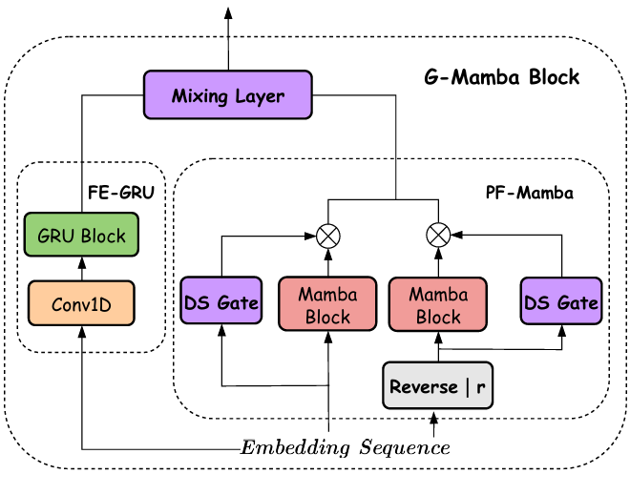
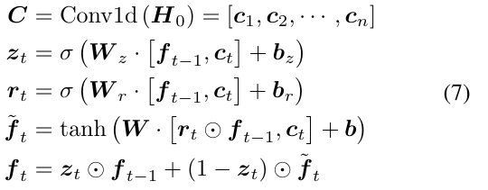
ATAI
Advanced Technique of Artificial Intelligence
ATAI
ChongqingUniversity _{AdvancedTechniqueof}
of Technology Artificial Intelligence
Chongqing University of
Technology
Chongqing University ^{ATAI}
_{of Technology} Advanced Techniqueof
Artificial Intelligence
Chongqing University of Technology
Chongqing University of Technology
Method

Slide 10
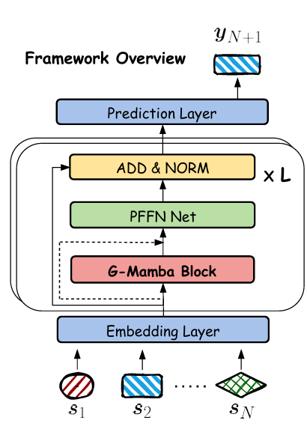
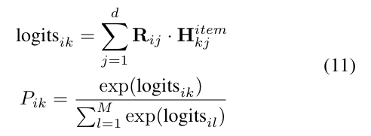
ATAI
Advanced Technique of Artificial Intelligence
ATAI
ChongqingUniversity _{AdvancedTechniqueof}
of Technology Artificial Intelligence
Chongqing University of
Technology
Chongqing University ^{ATAI}
_{of Technology} Advanced Techniqueof
Artificial Intelligence
Chongqing University of Technology
Chongqing University of Technology
Method

Slide 11
ATAI
Advanced Technique of Artificial Intelligence
ATAI
ChongqingUniversity _{AdvancedTechniqueof}
of Technology Artificial Intelligence
Chongqing University of
Technology
Chongqing University ^{ATAI}
_{of Technology} Advanced Techniqueof
Artificial Intelligence
Chongqing University of Technology
Chongqing University of Technology
Experiments

Slide 12
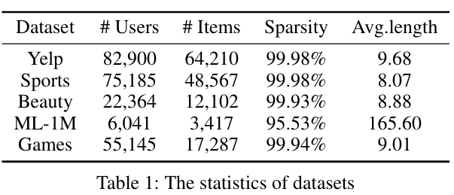
ATAI
Advanced Technique of Artificial Intelligence
ATAI
ChongqingUniversity _{AdvancedTechniqueof}
of Technology Artificial Intelligence
Chongqing University of
Technology
Chongqing University ^{ATAI}
_{of Technology} Advanced Techniqueof
Artificial Intelligence
Chongqing University of Technology
Chongqing University of Technology
Experiments

Slide 13
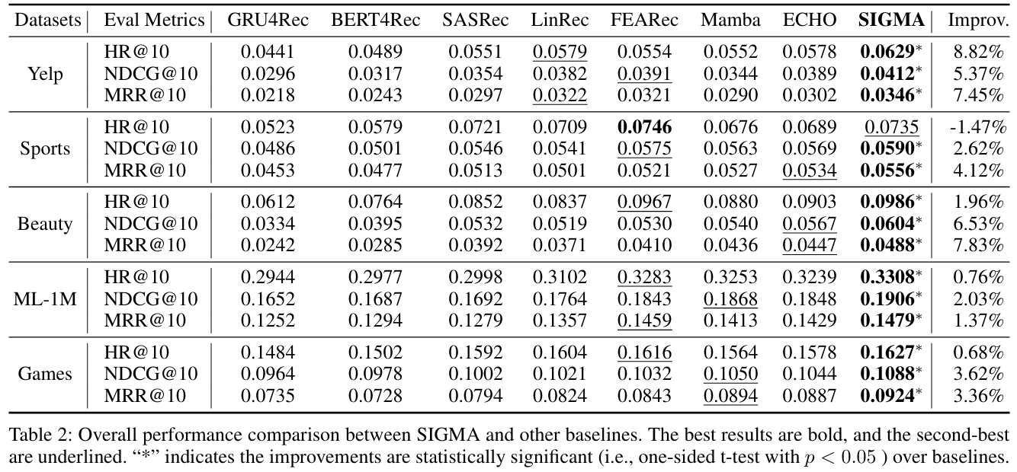
ATAI
Advanced Technique of Artificial Intelligence
ATAI
ChongqingUniversity _{AdvancedTechniqueof}
of Technology Artificial Intelligence
Chongqing University of
Technology
Chongqing University ^{ATAI}
_{of Technology} Advanced Techniqueof
Artificial Intelligence
Chongqing University of Technology
Chongqing University of Technology
Experiments

Slide 14
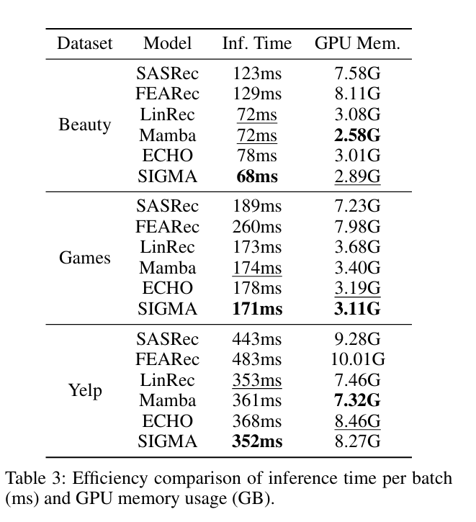
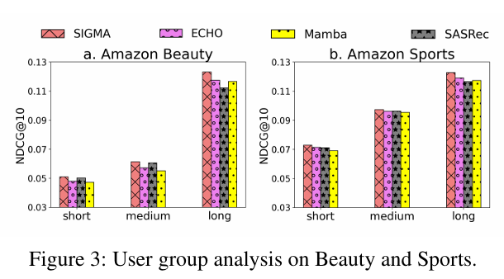
ATAI
Advanced Technique of Artificial Intelligence
ATAI
ChongqingUniversity _{AdvancedTechniqueof}
of Technology Artificial Intelligence
Chongqing University of
Technology
Chongqing University ^{ATAI}
_{of Technology} Advanced Techniqueof
Artificial Intelligence
Chongqing University of Technology
Chongqing University of Technology
Experiments

Slide 15
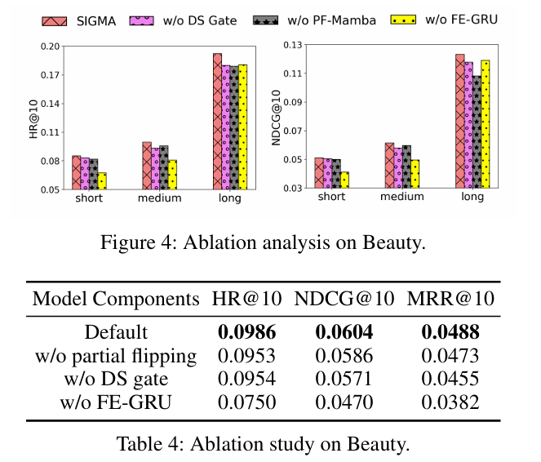
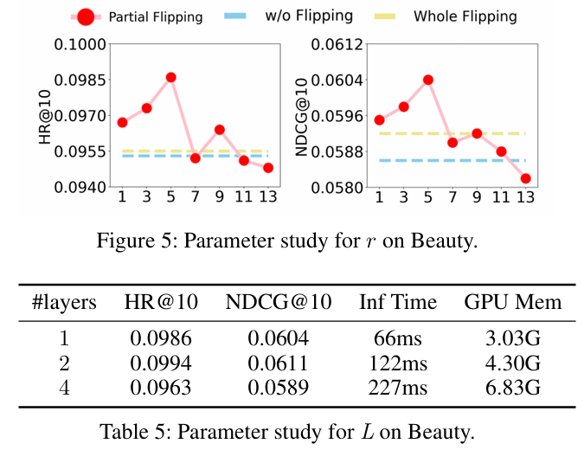
ATAI
Advanced Technique of Artificial Intelligence
ATAI
ChongqingUniversity _{AdvancedTechniqueof}
of Technology Artificial Intelligence
Chongqing University of
Technology
Chongqing University ^{ATAI}
_{of Technology} Advanced Techniqueof
Artificial Intelligence
Chongqing University of Technology
Chongqing University of Technology
Experiments

Slide 16
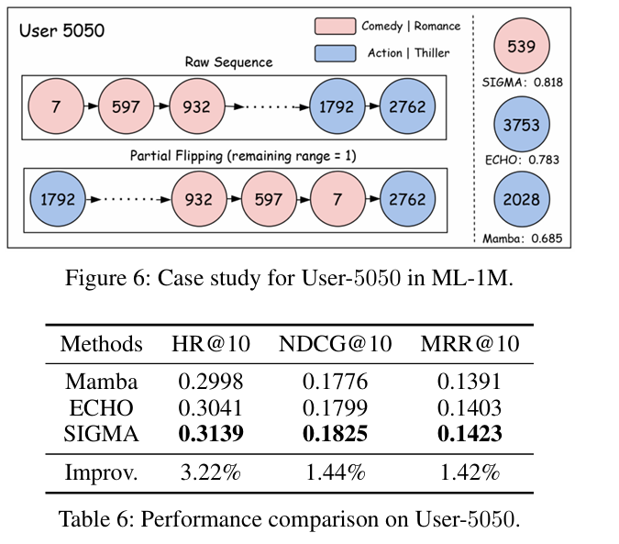
ATAI
Advanced Technique of Artificial Intelligence
ATAI
ChongqingUniversity _{AdvancedTechniqueof}
of Technology Artificial Intelligence
Chongqing University of
Technology
Chongqing University ^{ATAI}
_{of Technology} Advanced Techniqueof
Artificial Intelligence
Chongqing University of Technology
Chongqing University of Technology
Experiments

Slide 17
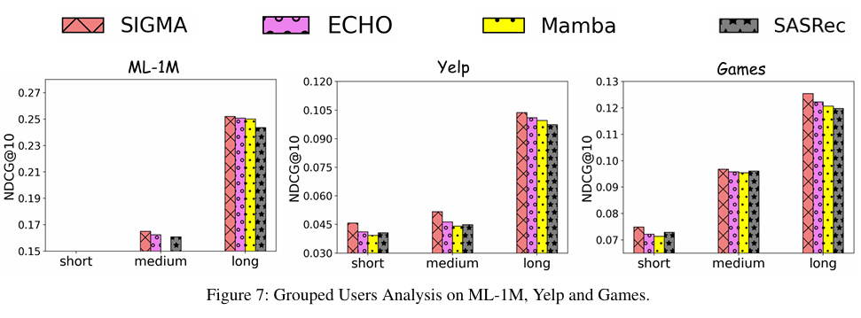
ATAI
Advanced Technique of Artificial Intelligence
ATAI
ChongqingUniversity _{AdvancedTechniqueof}
of Technology Artificial Intelligence
Chongqing University of
Technology
Chongqing University ^{ATAI}
_{of Technology} Advanced Techniqueof
Artificial Intelligence
Chongqing University of Technology
Chongqing University of Technology
Experiments

Slide 18
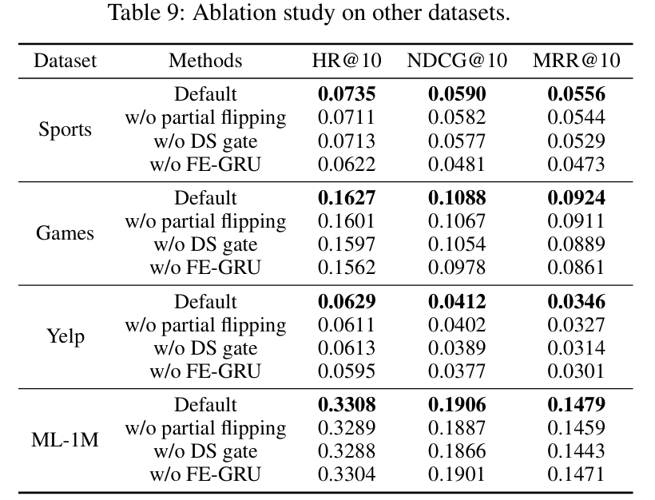
ATAI
Advanced Technique of Artificial Intelligence
ATAI
ChongqingUniversity _{AdvancedTechniqueof}
of Technology Artificial Intelligence
Chongqing University of
Technology
Chongqing University ^{ATAI}
_{of Technology} Advanced Techniqueof
Artificial Intelligence
Chongqing University of Technology
Chongqing University of Technology
Experiments

Slide 19
ATAI
Advanced Technique of Artificial Intelligence
ATAI
ChongqingUniversity _{AdvancedTechniqueof}
of Technology Artificial Intelligence
Chongqing University of
Technology
Chongqing University ^{ATAI}
_{of Technology} Advanced Techniqueof
Artificial Intelligence
Chongqing University of Technology
Chongqing University of Technology
Thanks!

